Slide 1

Advanced Software Engineering
Prof. Harold Liu
Head of Department, Software Service Engineering
Beijing Institute of Technology
Email: liuchi02@gmail.com
http://haroldliu.weebly.com
7 Oct 2014

Slide 2




Aloha from Harold
Head of Department of Software Service Engineering
http://haroldliu.weebly.com
B.Eng. degree from EE Dept.
Tsinghua University
Ph.D. degree from EEE Dept.
Imperial College, UK
Staff Researcher
IBM Research - China
PostDoc Researcher
Deutsche Telekom Labs, Germany
Visiting Researcher
IBM T.J. Watson Research Center, USA

Slide 3

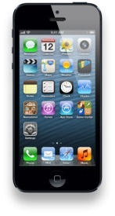
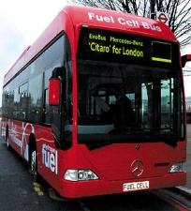



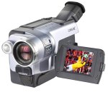
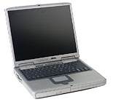
Cloud Computing and Big Data
Data Center
IoT
Enterprise IT Sys
Public Network
Control Server
Gateway
App Server
UbiComp
IP Core
Sensors
3G/4G
IEEE
AP/hotspots
Augmented Reality
BS
Wireless
WMAN
Ad-Hoc

Slide 4

Course Arrangement
Lecture time: WK4-21, Tues 2:00pm-4:50pm, Rm 423
Office Hours: Friday 1:30pm - 2pm
Notice board
How am I evaluated?
  Attendance: 20’
  2 Courseworks: 30’
  1 team project: 20’
  Final exam: 30’
  “Extra” incentives: 10’
Coursework
Discussions
Q&A
Exams

Slide 5
Syllabus
Advanced Software Engineering Theory
  WK4-11
  Coursework 1
Cloud Computing and Big Data：
  WK12-16
  Coursework 2
  WK13 Project: completion within 5 weeks
Internet-of-Things：WK16-17
Q&A：WK19
Examination：WK20/21
Coursework Grading:
15: excellent
12: fair
9: poor but pass
Project Grading:
18-20: clear contribution
14-17: limited contribution
13: completion
12: submission

Slide 6
Advanced Software Engineering Theory
WK4: Introduction
WK7: Requirement Engineering
WK8: Software Design1
WK9: Software Design2
WK10: Agile Development
WK11: Project Management

Slide 7
Introduction to Cloud Computing and Big Data
WK12: Introduction to Cloud Computing
WK13 - 14: Datacenter Networks
WK14 - 15: Hadoop Ecosystems
WK16: Data Streaming

Slide 8
Introduction to the Internet-of-Things
WK17: Introduction, Sensor Technologies and RFID
WK18: Wireless Broadband Network and Mobile Communications Networks

Slide 9

Textbooks and References - Theory
Software Engr. by Ian Sommerville

Slide 10
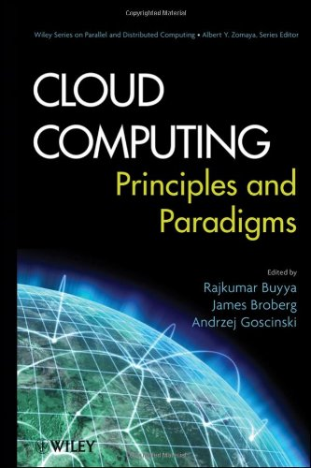

Cloud Computing and Big Data

Slide 11



Internet-of-Things
and IEEE Xplorer & ACM Digital Library…

Slide 12
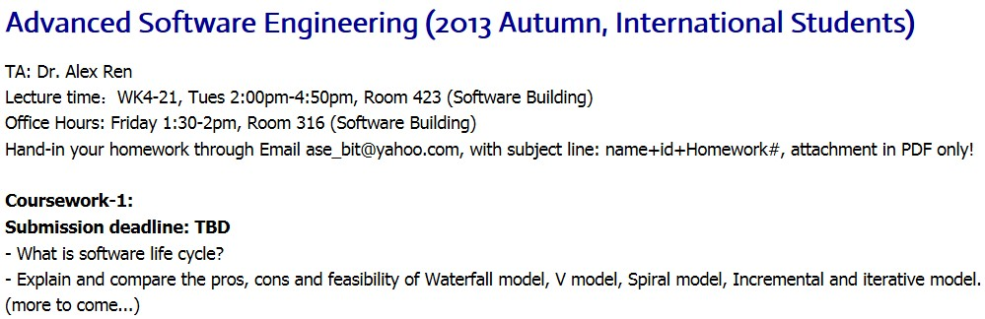
Homework on Notice Board!
http://haroldli.weebly.com/teaching.html
http://haroldliu.weebly.com/teaching.html

